Slide 1
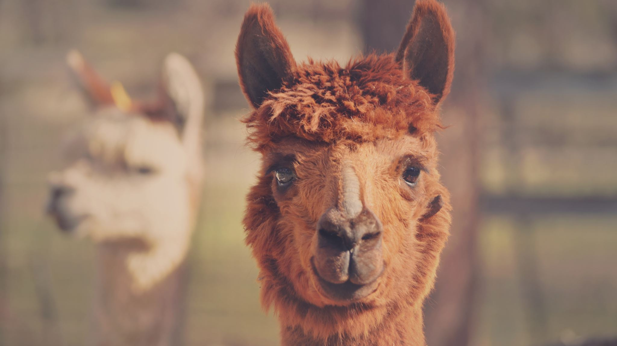
LLaMa-2, ChatGPT, and Generative Modeling
Prof. Sebastián Vallejo Vera

Slide 2
Large Language Models
In Weeks 9/10 we learned about the Transformers architecture. Model that use this architecture are called Large Language Model (LLM).
After all, these models are trained with LARGE amounts of text data in order to understand and replicate language.

Slide 3
GPTs
GPT = Generative Pre-trained Transformer
This means, a model that has been pre-trained using the Transformers architecture, and that can generate new text from a given prompt.
Popular examples are OpenAI ChatGPT-3.5, OpenAI ChatGPT-4, LLaMa2, Vicuna, Falcon, etc.

Slide 4
How do GPTs work?
Broadly speaking, GPTs are Transformers-based models fine-tuned to generate text by predicting the next word in a sentence.
The more tokens the model has seen, the better is will be at predicting (and, thus, generating) new tokens.
For example, when you ask a ChatGPT a question, in part what the model does is predict the next token, based on the information provided (i.e., a prompt with a combination of tokens, in a given order).

Slide 5
Why are GPTs so good now?
Improvements are a product of increased data and increased parameters (and improvements in computational power).
GPT-3 was trained using 500 billion tokens and 175 billion parameters.
Newer GPT models were developed as a closed-source model. So we do not know exactly how GPT-3.5 and GPT-4 were trained.
However, new powerful models (such as LLaMa-2) have been developed and remained open-source, so we can have an idea of what is going on underneath the hood.

Slide 6
OpenAI’s ChatGPT and Meta’s LLaMA-2

Slide 7

What can we do with these models?
Well, ChatGPT / LLaMa can write essays. It is also pretty good at mimicking human speech.
It can answer questions pretty well. I have been using GPT models to label data. Some researchers have been using them to classify emotions.
You can also create text (and images), which can be useful for survey experiments.

Slide 8
However, there are limits, some of which are important to be aware of when using these models.
Kocoń et al. (2023) argue that ChatGPT is a “jack of all trades, master of none”.
This means that is has a hard time letting go of what it already knows (i.e., it has a static memory – I made that term up). It is difficult to teach it the same concepts in a different way.
Keep this into account when using ChatGPT and LLaMa

Slide 9
One advantage of LLaMa-2 is that its most potent version is, apparently*, just as good as ChatGPT while also being open-source (i.e., free and customizable).
This means that we can further pre-train LLaMa-2 with a series of prompts and answers. We can change its memory.
We can also change the pre-prompt (also made that term up).
One limitation of LLaMa-2 is its size… its heavy and you are unlikely to be able to run it in your own computer and will likely require a specialized server.
These servers are still MUCH cheaper than using ChatGPT. For example, one million tokens will cost you $1. The same amount of tokens in GPT-4 will cost you around $20. It can quickly add up.

Slide 10
How to access these models (from your computer)
You can access the playground of OpenAI’s ChatGPT by signing up in https://chat.openai.com/
You can access the playground of Meta’s LLaMa-2 by accessing https://www.llama2.ai/
To connect directly to ChatGPT you need to connect through their API. I will give you code to do this, however, this is a paid service, so it is sort of up to you. Less powerful versions of ChatGPT (e.g., GPT-3.5) are quite affordable if you are interested in testing it out.
To connect directly to LLaMa-2 (through Huggingface) you need to request access by logging in to HF and accessing this link: https://llama.meta.com/llama-downloads/

